Slide 1
Prosthetic Hand Control via Shoulder Movement
Nitay ozer
Itay mal
supervisor KobY Kohay

Slide 2

Problem Definition
Wirelessly controlling Haifa 3D robotic prosthetic hand
Using user’s shoulder movements

Slide 3

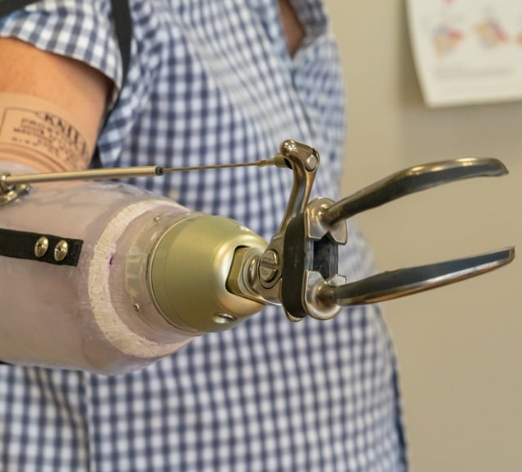
Existing solution- Mechanical Straps
Pros:
Simple
Reliable
Independent of power source
Cons:
Requires a lot of physical effort to operate
Limited in DOF
Unnatural look

Slide 4
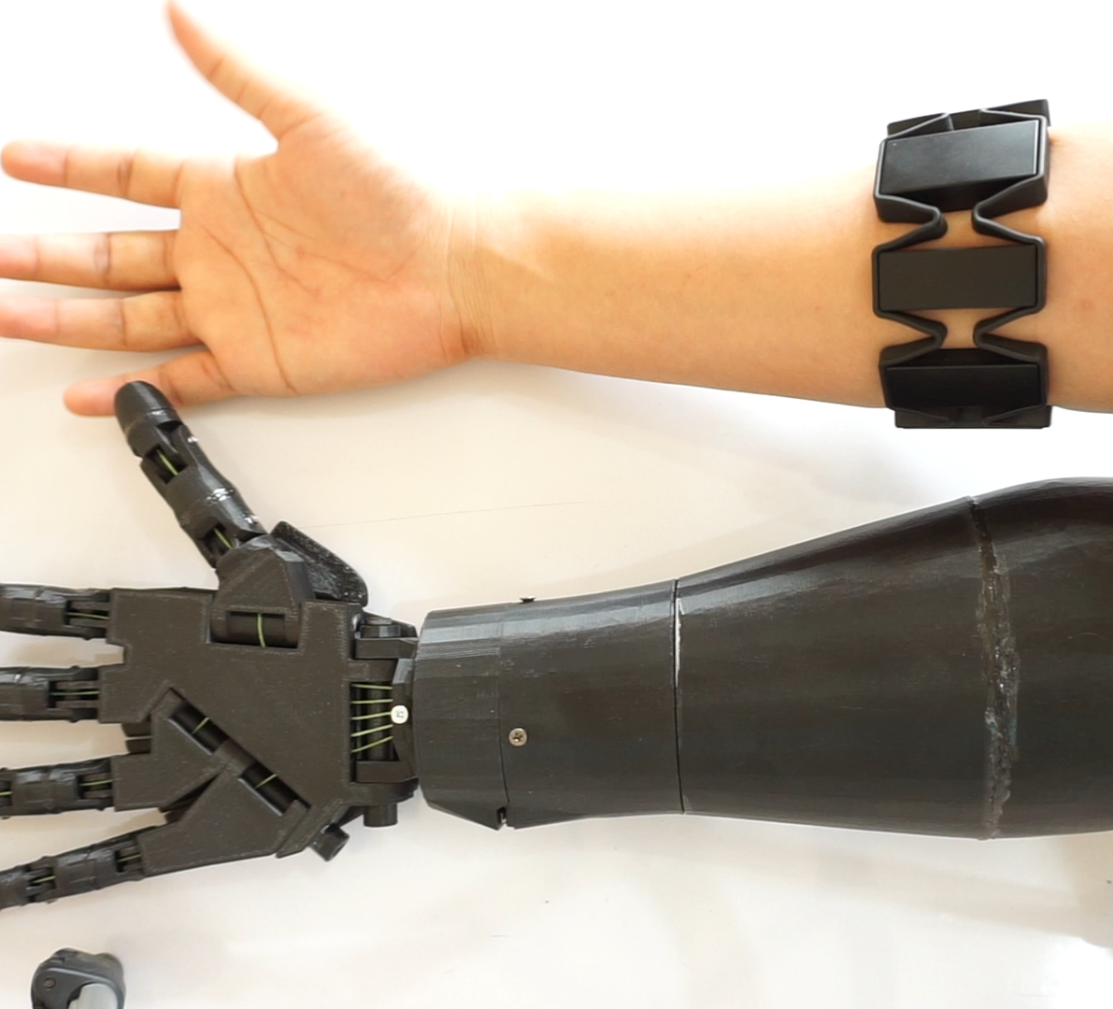
Existing solution- Myoelectric (EMG) Control
Pros:
High variety of DOF
Can look like natural arm
Intuitive operation*
Cons:
Expensive
Heavy
High power consumption
Phantom pain*

Slide 5
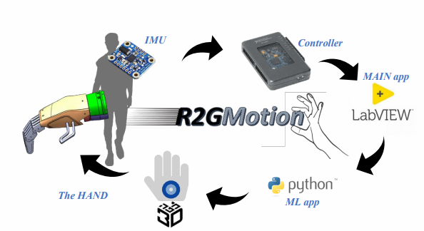
Previous Work- Shunit Polinsky
Reach to Grasp
IMU based method
Recognition of natural movement patterns

Slide 6

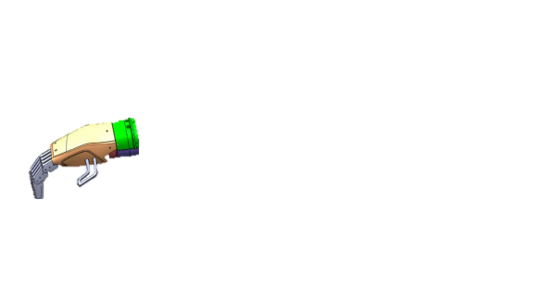

Block Diagram
Our System
Shoulder Movement
IMU Sensors
ESP32

Slide 7
Possible Approaches

Slide 8
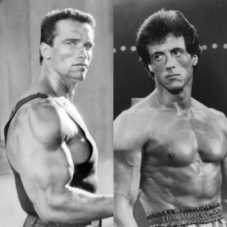
Mode Cycling
On/Off
Pros:
Easier movement identification
Less actions to remember
Cons:
Less immediate operation
Need to remember state sequence
Next Mode
Prev. Mode

Slide 9
Mode Mapping
Idle
Pros:
Immediate activation of wanted mode
Cons:
Harder movement identification
Need to remember state location
Limited amount of accessible modes
M5
M1
M2
M4
M3

Slide 10
Complex Gestures Mode Mapping
M1
Pros:
Immediate activation of wanted mode
More modes accessible
Cons:
Even harder movement identification
More complex gestures to learn
May look awkward
M3
M2

Slide 11
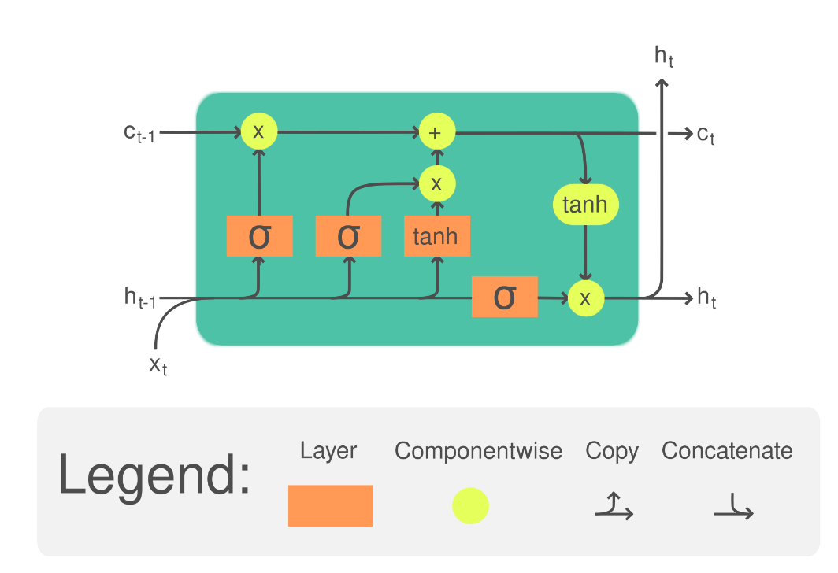
LSTM
Pros:
Adequate to temporal data
May be used as classifier
Cons:
Computationally expensive
Hard to implement for microcontroller
Many learned parameters

Slide 12
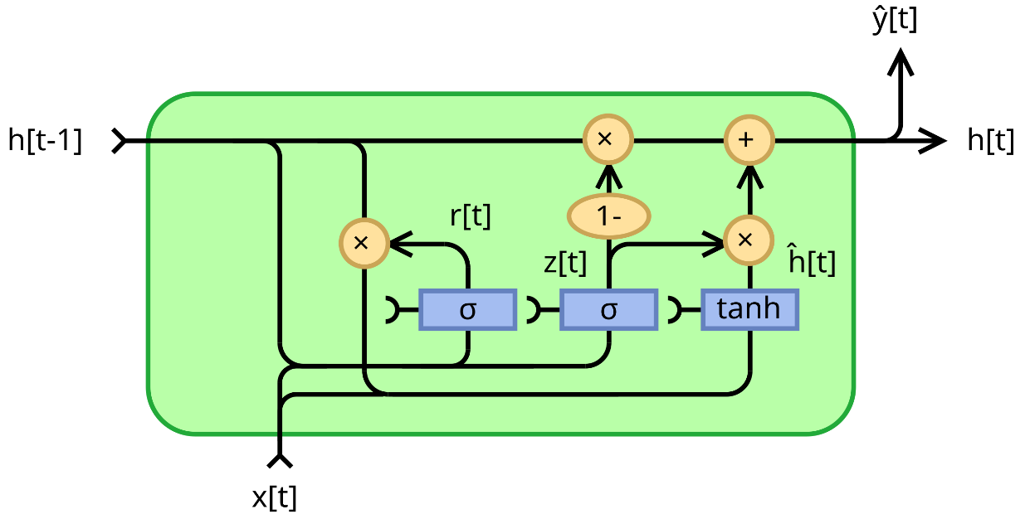
GRU
Pros:
Adequate to temporal data
May be used as classifier
Slightly less parameters than LSTM
Cons:
Computationally expensive
Hard to implement for microcontroller
Many learned parameters
Less weight for long term memory

Slide 13

Random Forest
Pros:
Easy and fast training
Highly fitted to classification tasks
Explainable
Fitted to microcontroller easily
Cons:
Not designed for temporal data

Slide 14
Purposed Solution

Slide 15
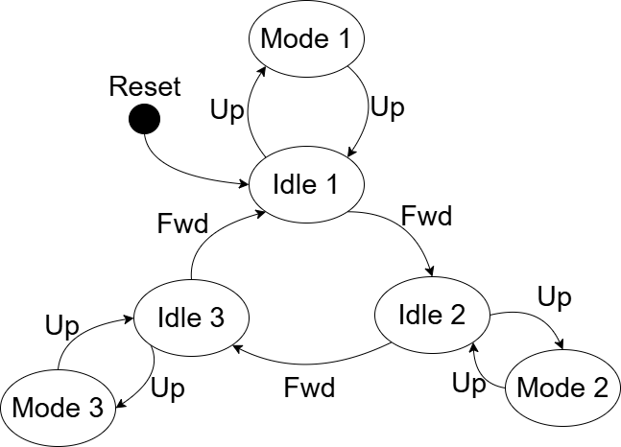
Simplified Mode Cycling
On/Off
Next Mode

Slide 16
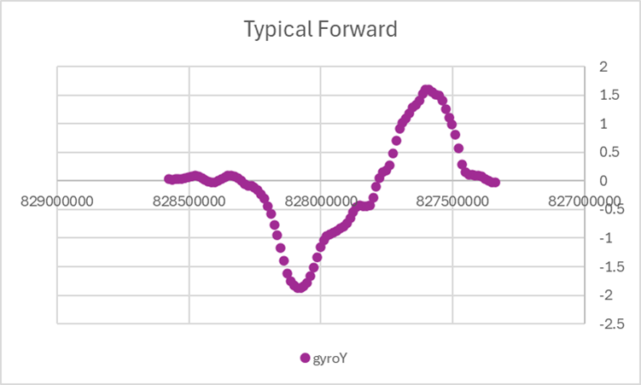
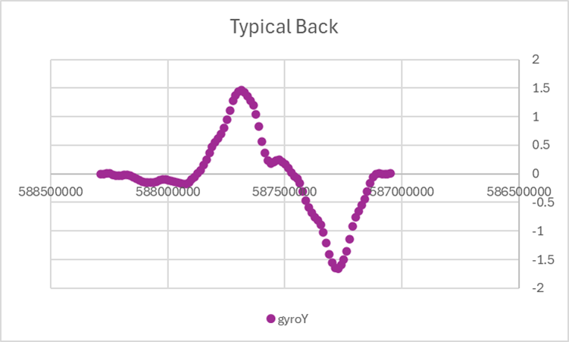
Forward / Back Symmetry

Slide 17
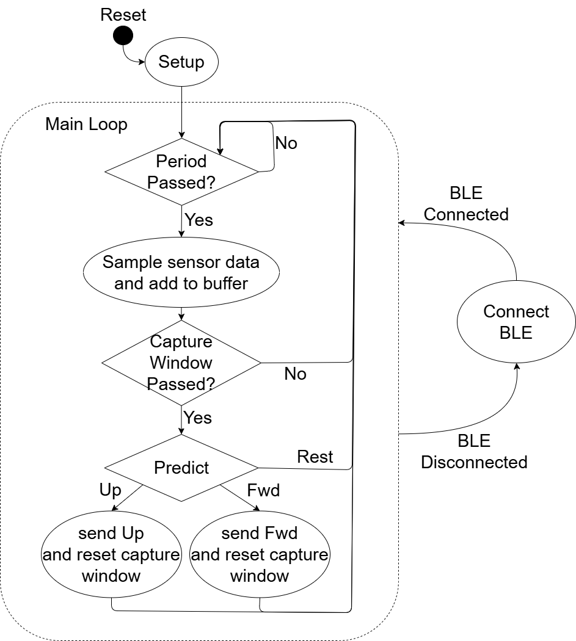
Program Flow
Sample rate – 80Hz
Buffer size – 100 timepoints
Prediction after each sample
Capture window prevents multiple hits from single gesture
BLE disconnection interrupts flow

Slide 18
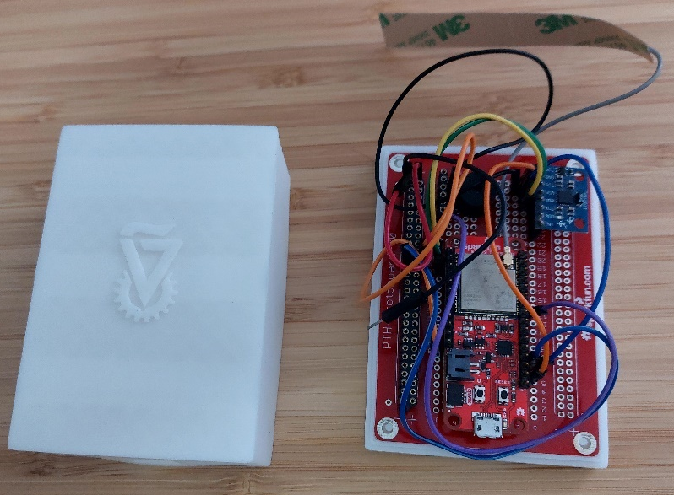
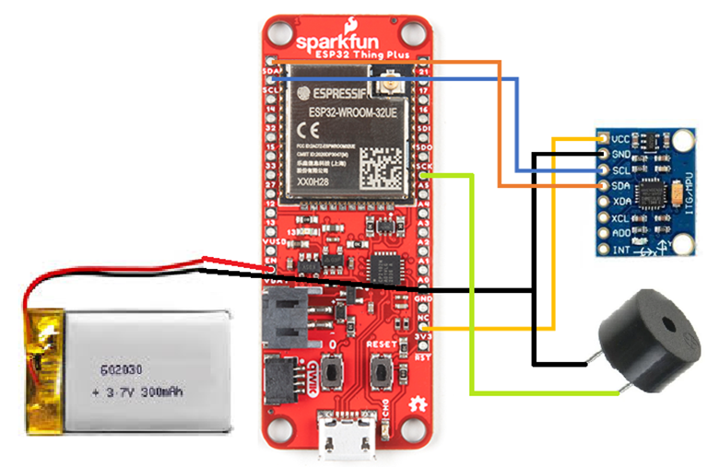
System Interconnection
ESP 32
IMU
3.7V Battery
Buzzer

Slide 19
Demo

